Slide 1

Development of an automatic spelling correction tool for analyzing clinical text in Russian
Student: Dmitry Pogrebnoy, J4132c
Head of Practice from the trainee’s host organization: Sergey Kovalchuk, PhD
Scientific assistant: Anastasia Funkner, engineer

Slide 2
Electronic medical records
In healthcare, there are various predictive and decision-making models based on information from patients' medical records
The quality of such models strongly depend on the quality of the source texts
Electronic patient data is usually presented in plain text and contains a lot of spelling errors
Spelling errors in the source texts greatly reduce the quality of the final models and therefore require correction
2/7

Slide 3

Goal and tasks
Goal: Develop an automatic spelling correction tool for analyzing clinical texts in Russian. The tool should accept raw medical text as input and return corrected text with a minimum number of incorrect words.
Tasks for first semester:
Make an overview of the Russian medical texts correction
Analyze existing solutions in this area
Develop the first draft of the architecture of the tool
3/7

Slide 4
Existing tools
Tool | Error precision | Lexical precision | Overall precision | Average words per second
Aspell-python | 0.65 | 0.775 | 0.7125 | 353
PyHunspell | 0.59 | 0.49 | 0.54 | 11.5
PyEnchant | 0.6 | 0.455 | 0.5275 | 26.4
LanguageTool-python | 0.64 | 0.845 | 0.7425 | 19.1
PySpellChecker | 0.335 | 0.765 | 0.55 | 4.3
SymspellPy | 0.42 | 0.78 | 0.6 | 15892.1
Jumspell | 0.395 | 0.925 | 0.66 | 2043.2
Spellchecker prototype | 0.41 | 0.83 | 0.62 | 0.07
4/7

Slide 5
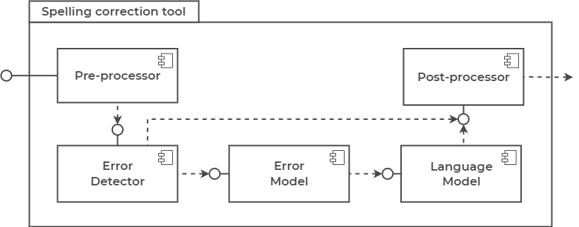
Principle architecture
5/7

Slide 6
Conclusion and further plans
The overview of the Russian medical texts correction are made
The analysis of existing spelling correctors is carried out
The principle architecture of the tool is developed
Further plans:
Finish the development of the architecture of the tool
Implement a tool for correcting spelling errors
Conduct testing of the developed tool
6/7

Slide 7

Thank you for your attention!
www.ifmo.ru

Slide 8
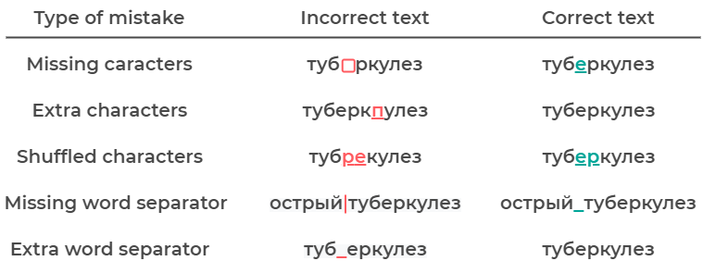
Spelling errors in question
8/7

Slide 9
Testing an existing tools
Error precision - the ratio of the number of correctly corrected words to the total number of incorrect words
200 medical words with spelling errors were taken to compute error precision
Lexical precision - the ratio of the number of unchanged modified words to the total number of correct words
200 correct medical words were taken to compute lexical precision
The performance test was done on a laptop on Ubuntu 20.04 with 16 GB RAM and Intel Core i7-9750H CPU @ 2.60GHz * 12
9/7

